Slide 1




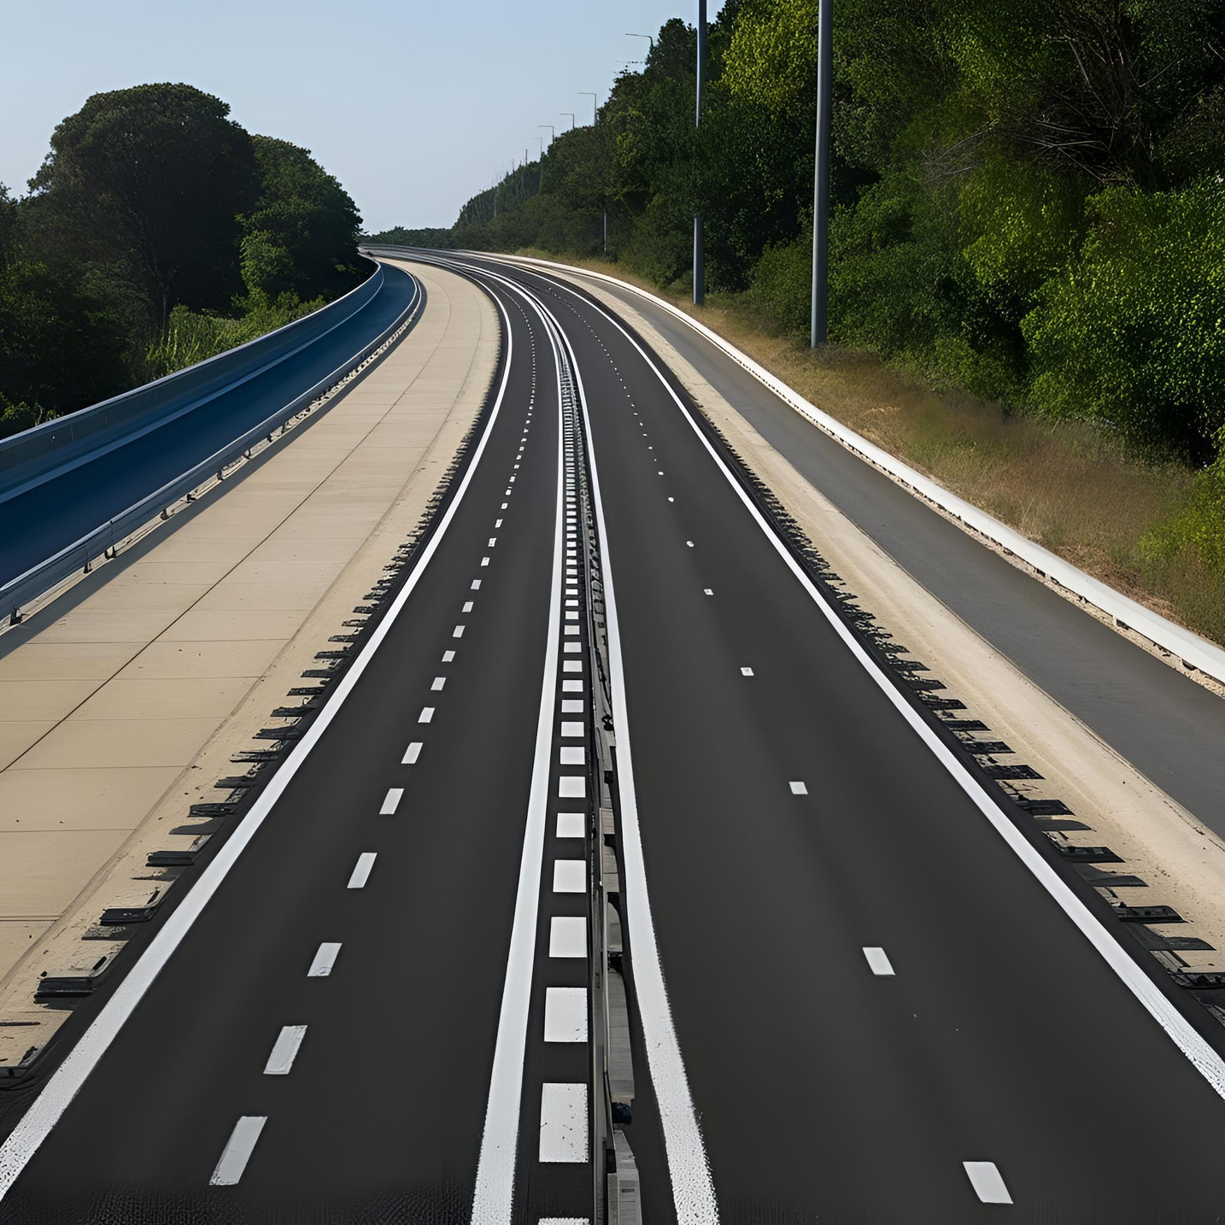




Lane Detection For Self Driving Cars
Roshini Bugginni- AP22110010141
Manas Kannikanti- AP22110010164
Soumya Karuturi - AP22110010175
Vishwajith Musulla- AP22110010274

Slide 2


What is Lane Detection ?
Lane detection is a computer vision technique which involves identifying lane markings on roads from images or video frames. It helps to determine the vehicle's position within a lane and assist with path planning. It is used in autonomous driving systems and advanced driver assistance systems (ADAS) as it keeps the vehicle safely within its lane and reduce accidents.

Slide 3
How It Works
CAPTURE IMAGE/VIDEO
A camera mounted on a vehicle captures real-time video frames which includes lanes, signs, vehicles etc.
PREPROCESSING
Grayscale Conversion
Converts color image to a single intensity channel and simplifies processing.
Gaussian Blur
Smooths the image to remove noise.

Slide 4
EDGE DETECTION
Using Canny Edge Detection technique to find out the boundaries or lanes.
REGION OF INTEREST
Focus only on the lower half of the image, where road and lanes are expected and discard irrelevant areas (sky, building, tress, etc).
LANE DETECTION
Applying Hough Transform to find out the straight solid lanes and for dashed lanes transition frequency analysis is required.
OVERLAY
Detected lanes are drawn in color on an original image.

Slide 5
Types of Lanes Detection
Straight Solid Lanes
Technique : Hough Line Transform
To detect straight, continuous lane lines.
It has little variation in pixel intensity.
Straight Dashed Lanes
Technique : Hough Line Transform + Transition Frequency Analysis
To detect discontinuous lane lines
High variations in pixel intensity.
A high number of transitions means the line is interrupted frequently and when crosses the threshold it is marked as a dashed lane.
Note: Threshold is the fixed number of transitions
Transition means change between white to black or black to white

Slide 6
Curved Solid Lanes
Technique: Perspective Transformation + Polynomial Curve Fitting(2nd degree)
To detect smoothly bending, continuous lane markings in a bird's eye view image.
It appears as a continuous curve with little to no break in pixel intensity.
Curved Dashed Lanes
Technique: Perspective Transformation + Polynomial Curve Fitting + Transition Frequency Analysis
To detect curved dashed markings by fitting a curve and checking for frequent pixel intensity changes.
The curve has many breaks, resulting in frequent white-to-black transitions.
Note : Birds eye view image is a type of image which looks at road from top view to make the road look flat or straight

Slide 7

Night Frame Detection & Enhancement
Night-time frames often have low visibility, making it difficult to detect lane lines accurately.
1. Frame Brightness Check
Convert frame to grayscale.
Calculate mean brightness.
If it's below a threshold (50) → treated as a night-time frame.
2. Image Enhancement for Night Frames
Convert frame to LAB (Brightness, Green, Blue) color space to enhance brightness & contrast.
Apply CLAHE (Contrast Limited Adaptive Histogram Equalization) to enhance local contrast.
Slightly increases overall contrast and brightness.
CLAHE (Contrast Limited Adaptive Histogram Equalization) is a method that makes dark areas of an image clearer without making bright areas too bright.
This improves lane visibility in low-light conditions, allowing accurate detection even at night.

Slide 8
Challenges in Lane Detection
1. Occlusions (vehicles, shadows): Region of Interest (ROI) selection focuses only on the lower part of the image (i.e., road area), which reduces interference from vehicles or irrelevant objects in upper regions.
2. Poor Visibility / Night Conditions: Brightness Check + CLAHE (Contrast Limited Adaptive Histogram Equalization) effectively improves visibility of lane lines under low-light conditions by enhancing contrast and brightness locally without overexposing brighter areas.
3. Faded / Discontinuous Lane Markings: Transition Frequency Analysis helps detect dashed or interrupted lines by identifying frequent white-black transitions, even when lane lines are faded or partially missing.
4. Curved Roads: Perspective Transformation + Polynomial Curve Fitting accurately models curved lanes, making it effective for winding roads and highway bends.
5. Noise / Irrelevant Features (e.g., trees, buildings): Preprocessing steps like Gaussian Blur and edge detection help suppress noise and enhance lane-specific features, isolating only what's necessary for accurate detection.
6. Complex Scenarios: While the current project uses classical techniques, it lays the foundation to integrate more advanced models (e.g., CNNs) in the future for handling edge cases like rain, fog, or crowded roads.

Slide 9
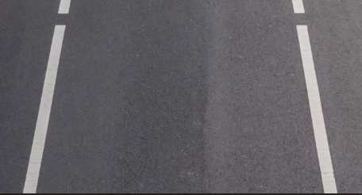
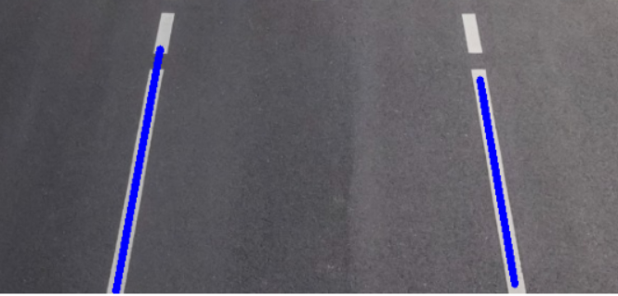
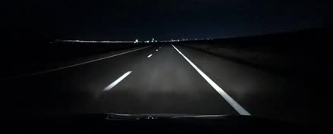
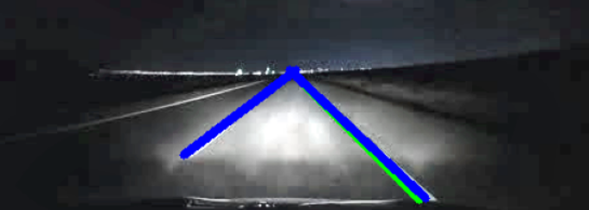
Results
Day
Night
Discontinuous lines appear blue and continuous lines appear green

Slide 10


Conclusion
It demonstrates an effective lane detection system for self-driving cars by leveraging preprocessing, edge detection, ROI masking and Hough Transform techniques to enable detection of straight and dashed lanes. Polynomial fitting to detect curved lanes and inclusion of night-time enhancement to increases system robustness under varying conditions.

Slide 11
Thank you

